Slide 1

Image Denoising by Using Wavelet Transform
Presented By:
Syeda Meher Niger
Immatrikulation Nr.: 65955
Semester Summer 2020
Submitted To:
Prof. Dr.-Ing. Christian Langen
Date: 29.06.2020

Slide 2
Discussion Topics
Why Wavelet Transform?
Image Denoising
Goal of the Project
Different Types of Noise
Software Tools Required
Differnent Noisy Images
Denoising of Different filters on different images
Implementation by Matlab and Results Analysis
Adding Different Filters and Results
Denoising of Wavelet based Threshold Methods and Results Analysis
Conclusion

Slide 3
Why Wavelet Transform?
Represent signals with a high degree of sparsity
Developed Independently
To get higher frequency information
For removing unwanted noise
Excellent localization property

Slide 4
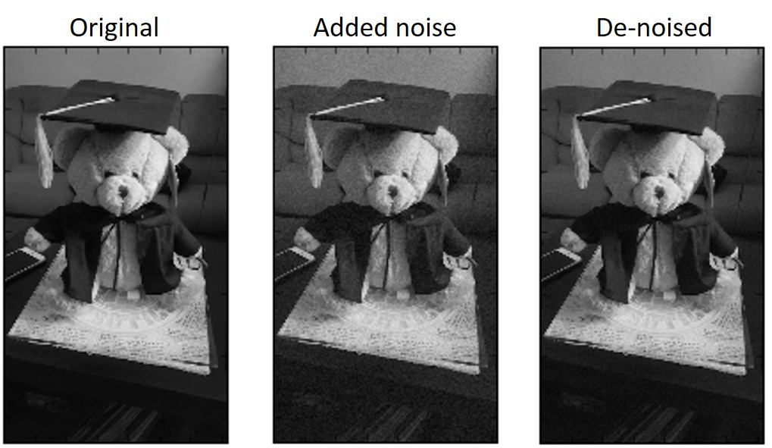
Image Denoising
Image denoising is the process of removing noise from an image

Slide 5
Goal of the Project
Wavelet algorithms are very useful tool for signal processing such as image compression and image denoising. The aim of this project is to study various thresholding techniques such as SUREShrink, VisuShrink, and BayeShrink and determine the best one for image de-noising.

Slide 6
Different Types of Noise
Gaussian Noise
Speckle Noise
Salt and Pepper Noise

Slide 7
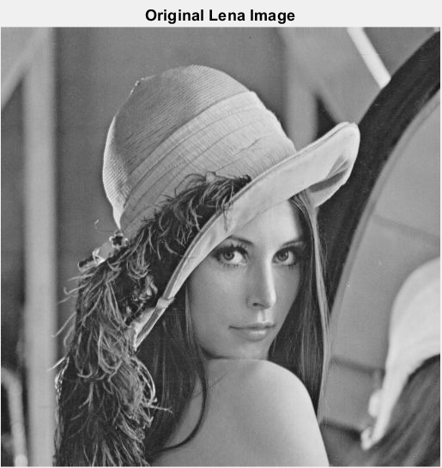
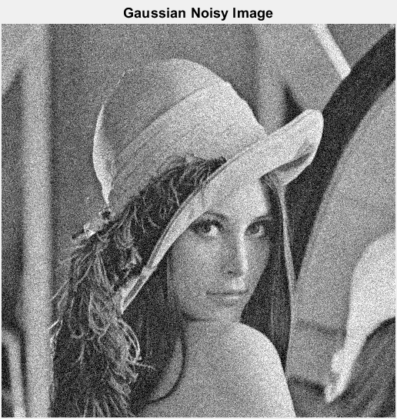
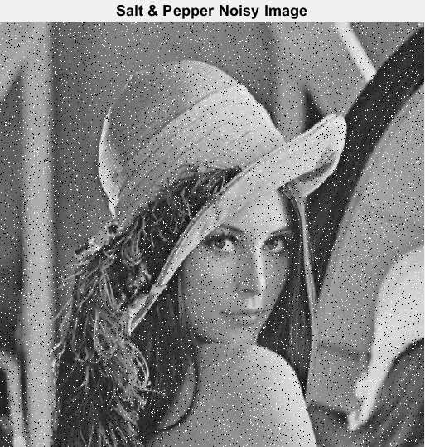
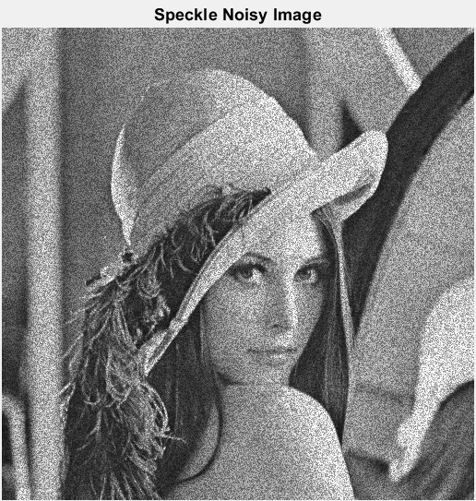
Different Noisy Images

Slide 8
SoftwareTools Required
MATLAB R2019a or Higher
Image Processing Toolbox
Wavelet Toolbox

Slide 9
Different Types of Denoising Filters
By Using Filters
Gaussian Filter
Average Filter
Wiener Filter
Median Filter

Slide 10
Applying Gaussian Noise on Original Image

Slide 11
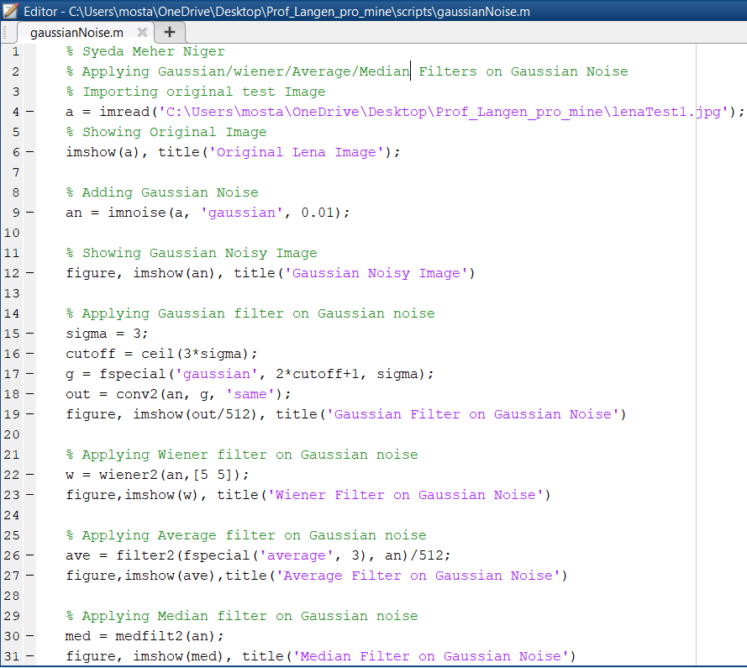
MATLAB Code for Denoising by Different Filters on Gaussian Noise

Slide 12
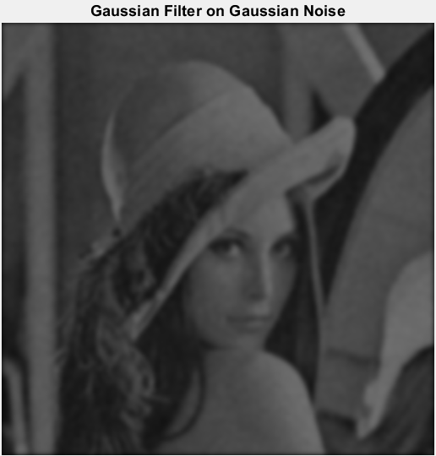

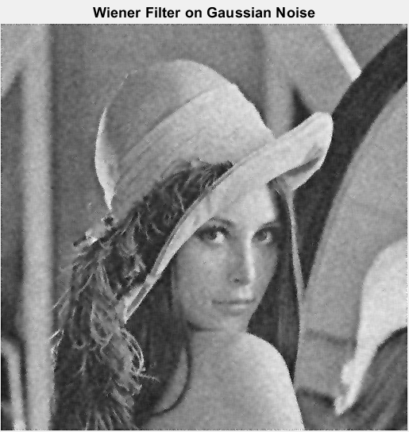
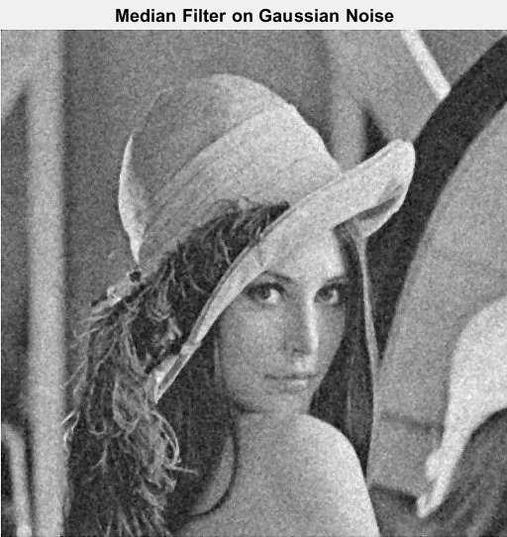
Denoising by Different Filters on Gaussian Noise

Slide 13
Applying Speckle Noise on Original Image

Slide 14
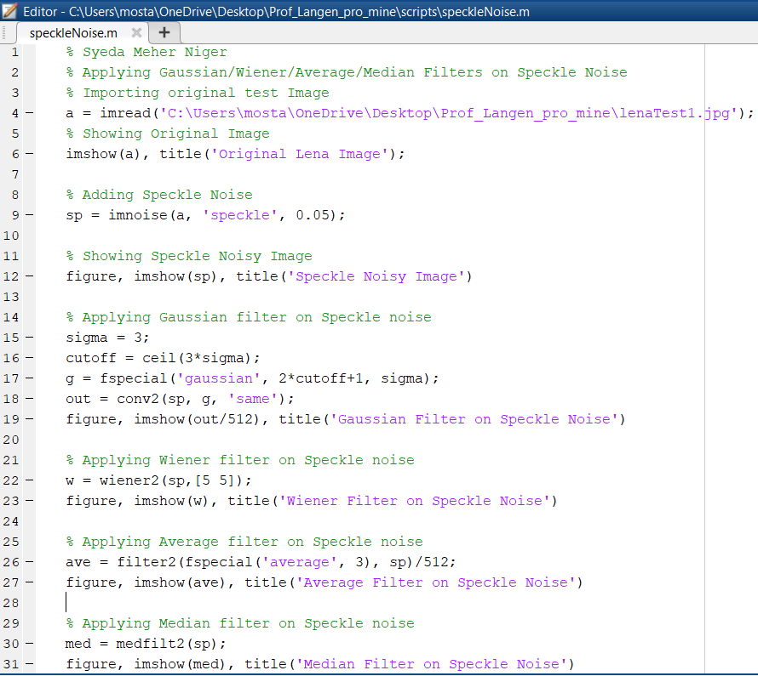
MATLAB Code for Denoising by Different Filters on Speckle Noise

Slide 15
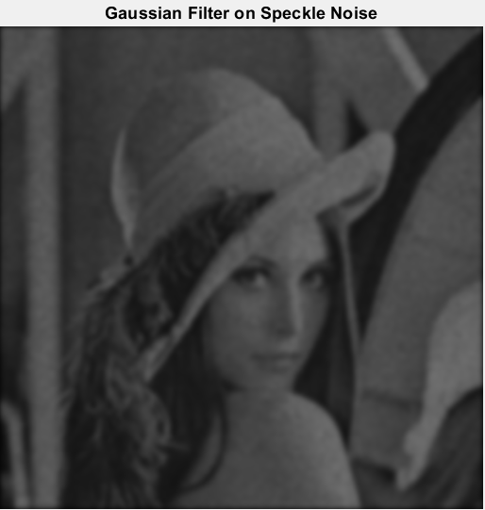
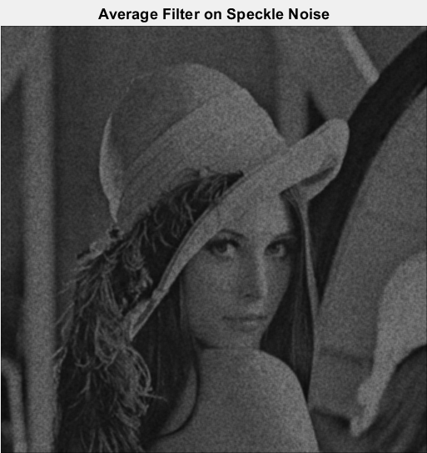


Denoising by Different Filters on Speckle Noise

Slide 16
Applying Salt and Pepper Noise on Original Image

Slide 17
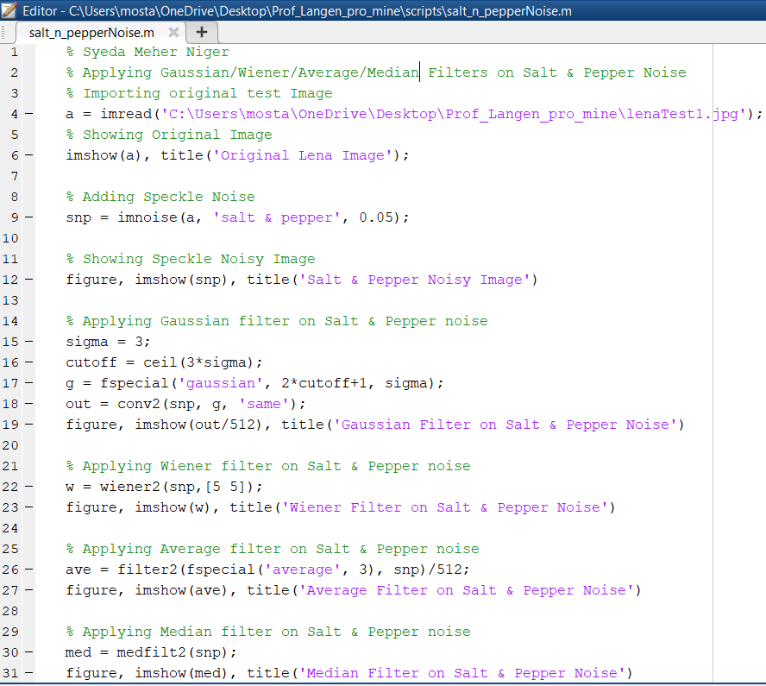
MATLAB Code for Denoising by Different Filters on Salt & Pepper Noise

Slide 18




Denoising by Different Filters on Speckle Noise

Slide 19
Denoising by Wavelet Based Threshold Methods:
Wavelet Based Threshold Methods:
Universal Threshold
(VisuShrink)
Sure Shrink
Bayes Shrink
FDR
MiniMax, etc
Wavelet Thresholding Types:
Hard
Soft
Mean
Median

Slide 20
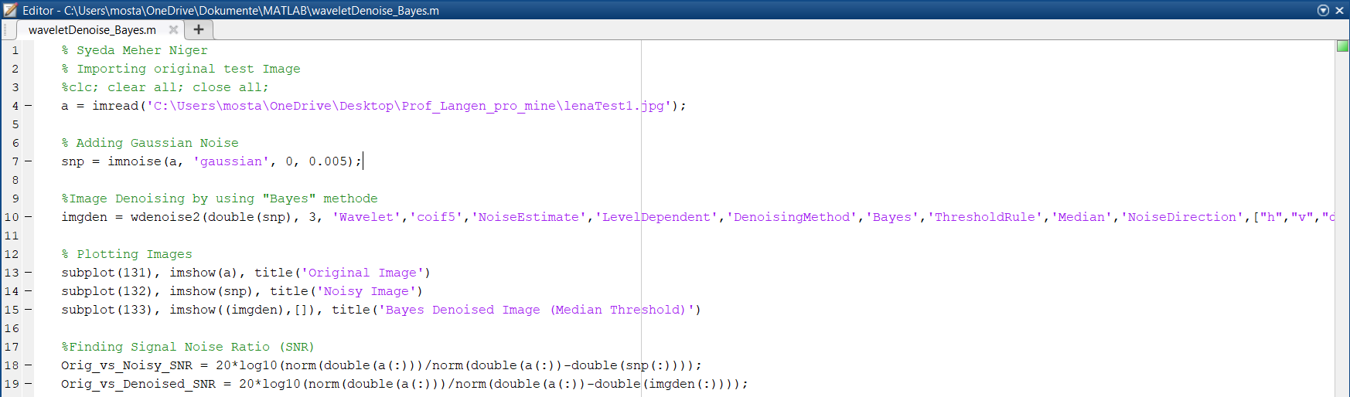
MATLAB Code for Denoising by Bayes Shrink on Gaussian Noise

Slide 21
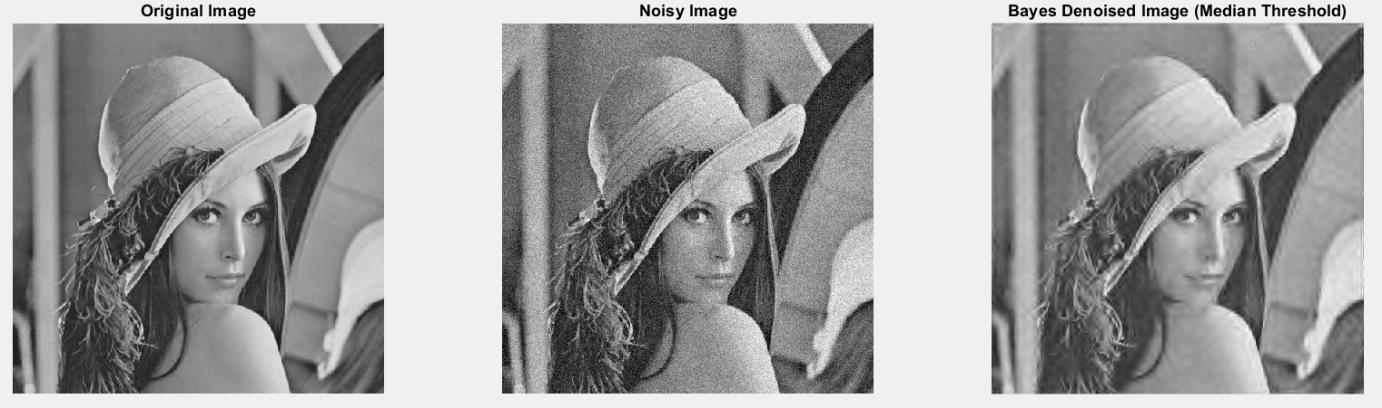
Denoising by Bayes Shrink on Gaussian Noise with Median Threshold

Slide 22
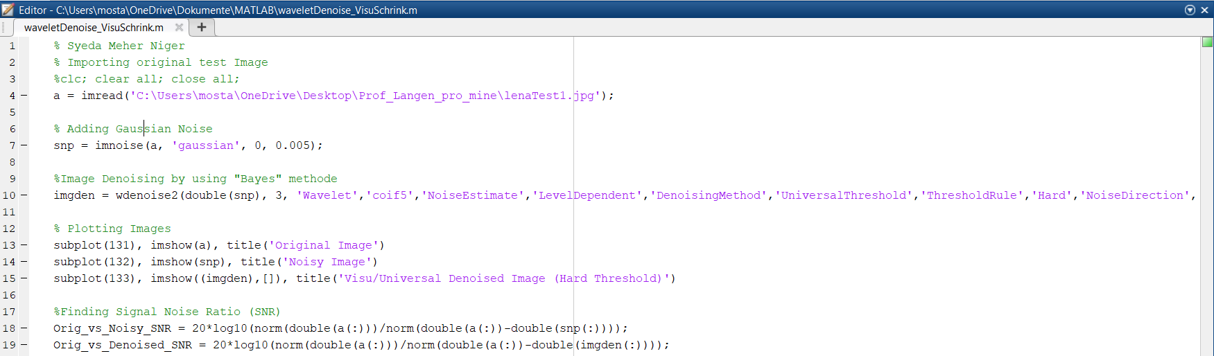
MATLAB Code for Denoising by Visu Shrink on Gaussian Noise

Slide 23
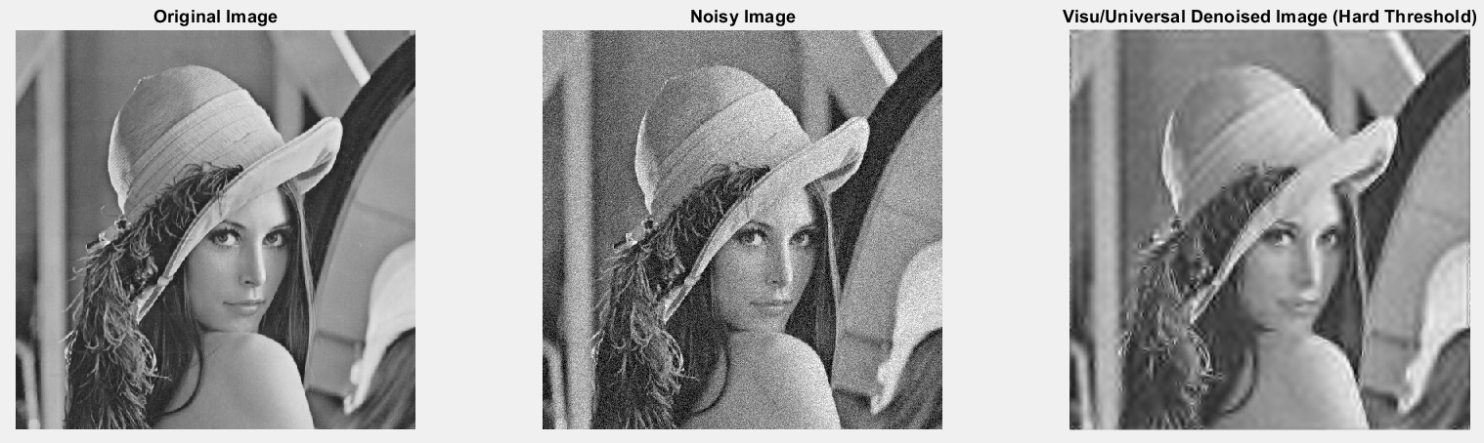
Denoising by VisuShrink on Gaussian Noise with Hard Threshold

Slide 24
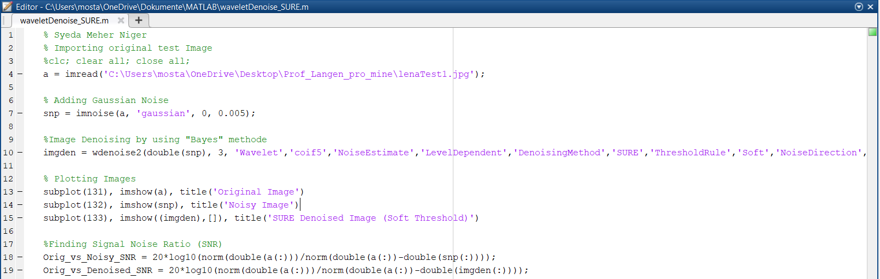
MATLAB Code for Denoising by SURE Shrink on Gaussian Noise

Slide 25
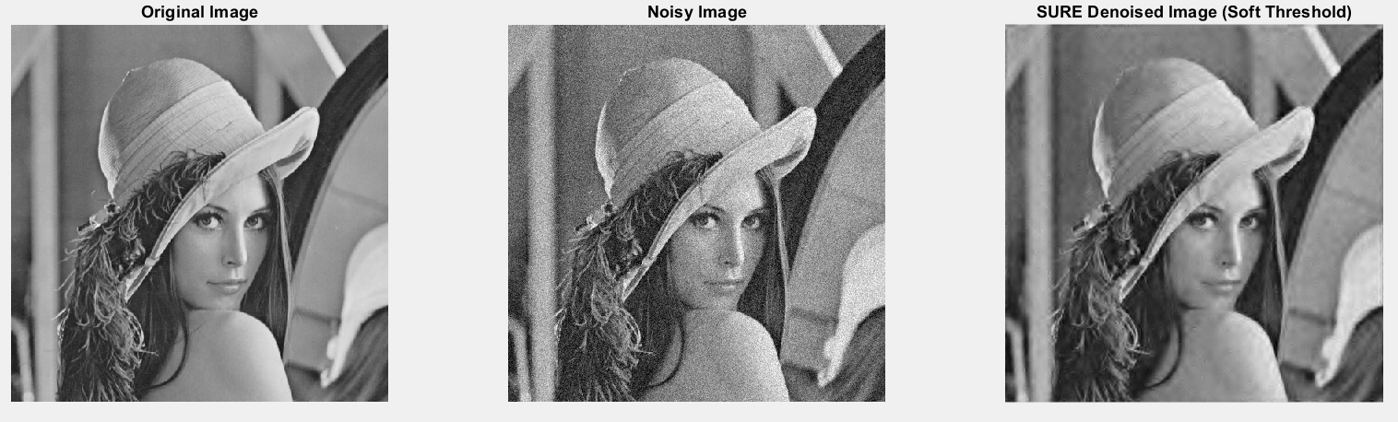
Denoising by SURE Shrink on Gaussian Noise with Hard Threshold

Slide 26
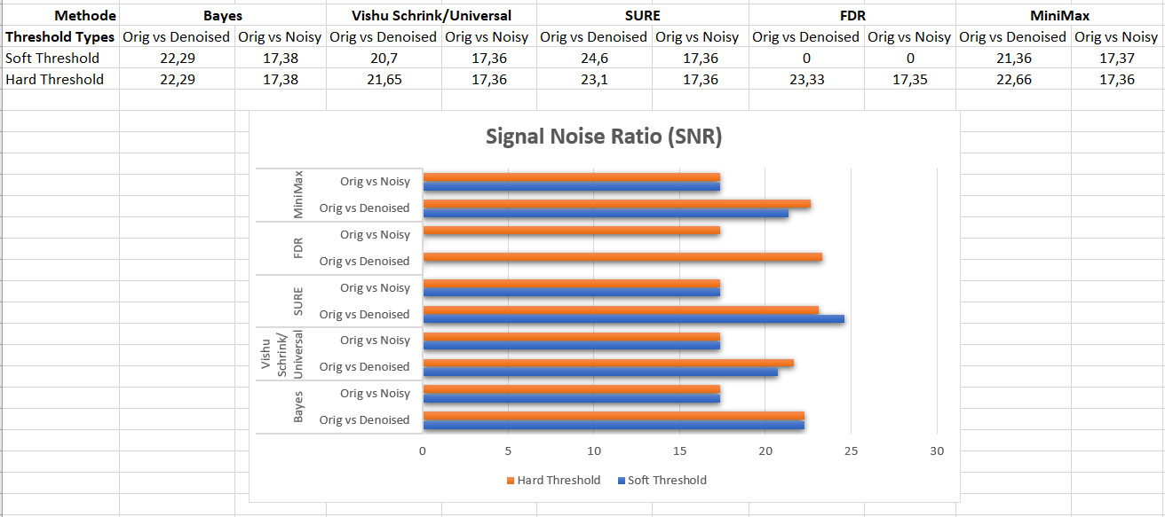
Signal Noise Ratio (SNR)

Slide 27
Conclusion
The wavelet denoising techniques offers high quality and flexibility for the noise problem of image processing. By using different filters I have observed that the performance of Median filter by using Salt and Pepper noise was better image quality. And median filter is also effective. And using MATLAB image processing and wavelet toolbox, the results obtained for different images by using VisuShrink, SureShrink and Bayes Shrink for image denoising Wavelet based threshold techniques.

Slide 28
